Slide 1
Digital Portfolio
STUDENT NAME: SADHISH.M
REGISTER NO AND NMID:
DEPARTMENT: BSC.COMPUTER SCIENCE
COLLEGE: SSBS/ ANNAMALAI UNIVERSITY

Slide 2

INTERACTIVE DIGITAL PORTFOLIO using html.css.js

Slide 3


AGENDA
Problem Statement
Project Overview
End Users
Tools and Technologies
Portfolio design and Layout
Features and Functionality
Results and Screenshots
Conclusion
Github Link
3/21/2024 Annual Review

Slide 4

PROBLEM STATEMENT
A problem statement of a portfolio is a clear, concise description of the specific issue or challenge that the portfolio (such as a project portfolio, investment portfolio, or design portfolio) aims to address or solve. It identifies the gap between the current state and the desired state, explains why the problem is important, who is affected, and what the impact is if the problem remains unsolved. The statement guides focus and priority for work done on the portfolio and serves as a foundation for finding solutions.

Slide 5

PROJECT OVERVIEW
Brief Summary of digital portfolio
It serves as an introduction to what the digital portfolio aims to showcase, highlighting key skills, achievements, and work samples. Typically, the overview outlines how the portfolio is organized to present the user's best work, relevant experiences, and unique attributes in a professional and visually appealing way.
Key elements in a digital portfolio project Such has skills(python,java) achievements(software developer), and career(IT) goals.Content: Includes high-quality work samples, project descriptions, a brief bio, skills section, testimonials, and contact information.Structure: Organized layout that facilitates easy navigation, often with sections like About Me, Work Samples, Skills(html,css,) and Contact.Design: Clean, consistent, and mobile-friendly design with an emphasis on visual hierarchy and user experience.

Slide 6

Main iedia of portfolio
Key elements of a digital portfolio include:
An introductory profile or "About Me" section with a brief bio, career goals, and contact details.A showcase of high-quality work samples relevant to the individual's field.Descriptions that explain the context, challenges, and skills demonstrated by each project.A list of key skills and technical proficiencies.Testimonials, awards, or recognitions for credibility.Multimedia integration such as videos, audio clips, interactive links, or virtual galleries.

Slide 7


WHO ARE THE END USERS?
Student (academic project,resumes)
Job sekers (to share with recruites)
Freelances (to show clients)
Professionals (to highlights experience and achievement)

Slide 8

TOOLS AND TECHNIQUES
HTML Structuring Content: HTML organizes web page content into sections
CSS styling(colours,layout,responsiveness)
Javascript Interactivity(navigation menu,animation)
Mention code editior(vs code) or codepen and hosting github

Slide 9
POTFOLIO DESIGN AND LAYOUT
HTML
LAYOUT
.
DIGITAL
PORTFO;IO
PYTHON
.
JS
CSS
.
Section included
Home/About ME
Project - (Digital portfolio)
Skills - (HTML,CSS,JS)
Contact – (phone no ,e-mails etc..)
Layout( grid layout)
9

Slide 10
FEATURES AND FUNCTIONALITY
A digital portfolio project typically includes features such as:
A selection of high-quality work samples or projects with descriptions explaining the creator's role, goals, and outcomes. Visual elements like images, screenshots, or videos enhance engagement.
Sections for certifications, awards, and recognitions to add credibility and demonstrate verified skills.
Testimonials and case studies that provide social proof and deeper narrative stories about problem-solving and project impact.
Clear contact information and a contact form to facilitate easy communication.
/An "About Me" section with a brief introduction, career goals, and personal background.
A skills section highlighting key competencies and relevant technologies.Interactive and multimedia …

Slide 11
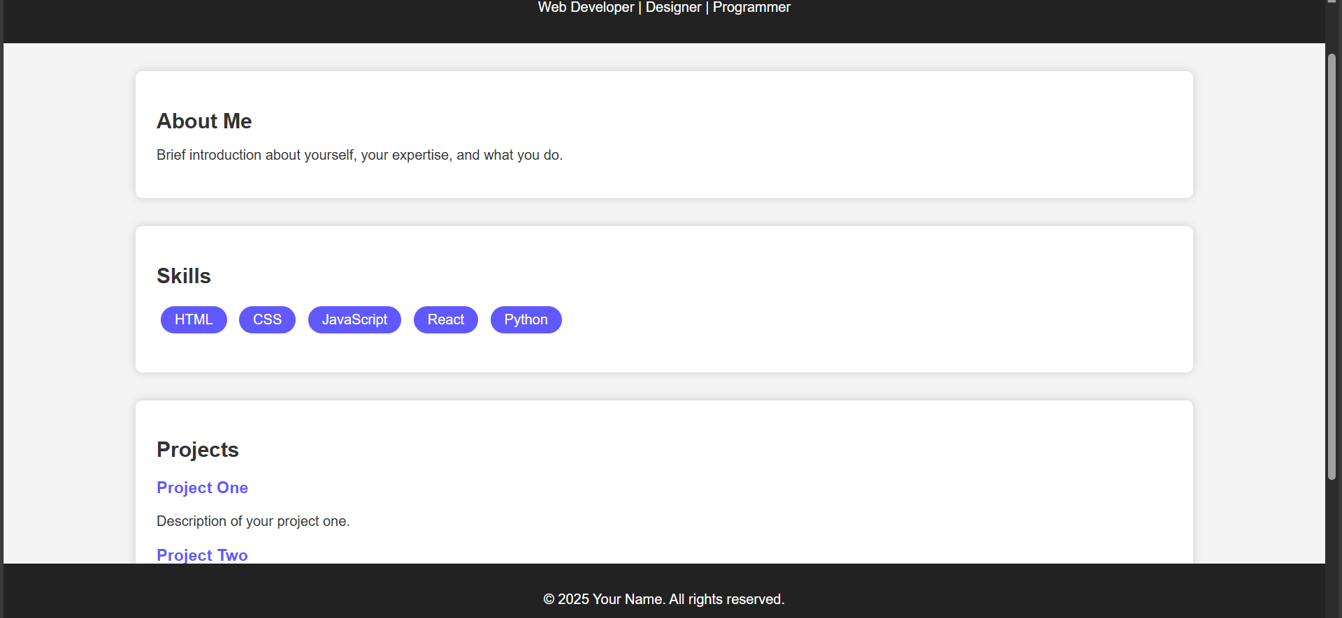

RESULTS AND SCREENSHOTS
3/21/2024 Annual Review
11

Slide 12
CONCLUSION
HIGHLIGHTS
VAREITY OF IMAGE ARE ADDED
EASY TO UNDERSTAND DIGTAL PORTFOLIO
NO OF TEMPLATES ARE ADDED
LAYOUT AND DESIGN
FINAL SUMMARY:
A digital portfolio is an online collection that showcases a person's skills, work samples, achievements, and experiences in a dynamic and visually appealing format. It serves as a professional presentation tool to demonstrate abilities and career growth to potential employers, clients, or collaborators. Key components of a digital portfolio include an "About Me" section, high-quality work samples with project descriptions, a skills listing, testimonials, contact information, and sometimes a resume. It may also contain multimedia elements like videos or links to demonstrate versatility.
12

Slide 13

BENEFITS OF SOCIETY: continuous and lifelong learning Personalized and self directed Enhanced Reflection and Growth mindsetve

